Slide 1
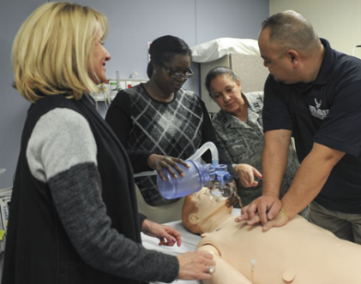
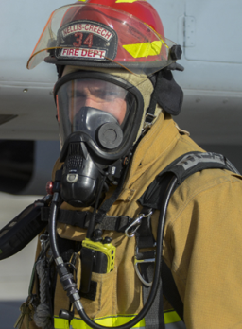
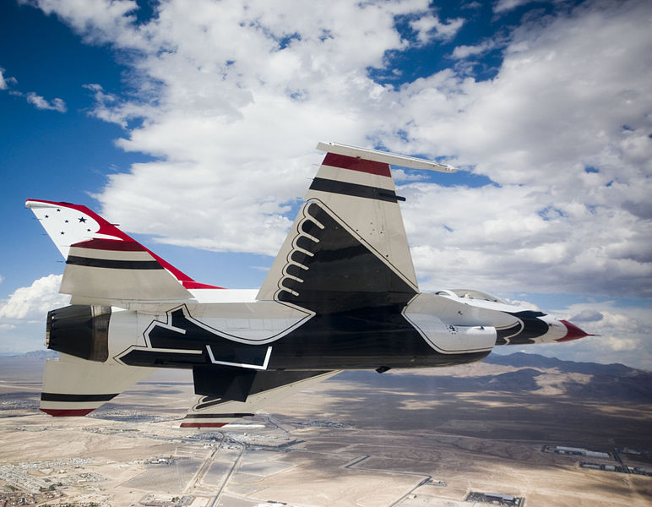
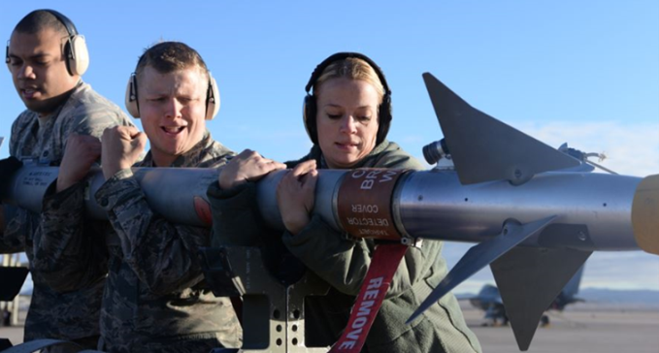
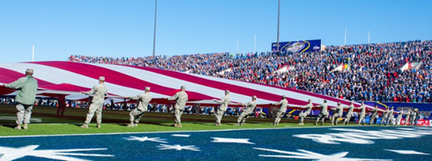
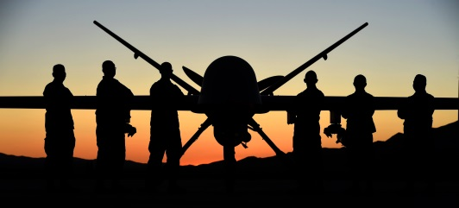
FISCAL YEAR
2017
Nellis Air Force Base (AFB) and Creech AFB have played important roles in southern Nevada since the early 1940s. Nellis AFB has a primary mission of training military personnel to fly, fight, and win utilizing the 2.9 million-acre Nevada Test and Training Range.
In January 2015, Nellis – the leader in combat aircrew training in the U. S. Air Force – welcomed its first F-35 Lightning II, the latest fifth-generation stealth multirole fighter, while Creech continues to be a pivotal resource in the fight continuously tasked by our nation’s leadership. From extensive combat operations to quick reaction humanitarian missions, the latest satellite technology allows Creech Airmen to fly remotely piloted aircraft locally and around the globe.
In order to support these diverse, complex missions, the installations are home to the largest civil engineer, communications, logistics readiness, and force support squadrons, as well as the largest medical center, in Air Combat Command. This Economic Impact Analysis provides information about Nellis’, Creech’s, and NTTR’s impact on the local economy. It provides the reader with a better understanding of how important the bases are to southern Nevada and their neighboring communities.
Nellis Air Force Base
Creech Air Force Base
Nevada Test and Training Range
Nellis Air Force Base
Creech Air Force Base
Nevada Test and Training Range
Economic Impact Analysis
Quick Reference Tables
99th COMPTROLLER SQUADRON
Notes:
ORIGINAL

Slide 2
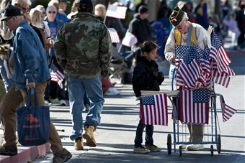
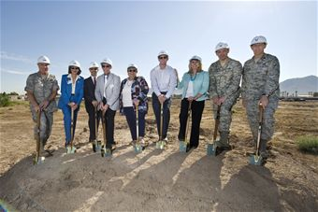
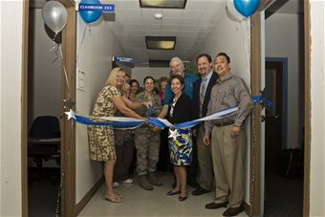
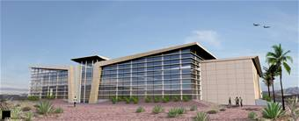
Quick Reference Tables
Table 3
Table 5
Retiree Presence & Payroll
Total Indirect Jobs Created
Economic Impact Analysis (EIA) FY17
Nellis, Creech, & the NTTR
Personnel Type | Retirees | Payroll
Air Force | 14,278 | $390.8M
Army | 5,593 | $143.5M
Navy | 6,452 | $166.6M
Marines | 1,547 | $45.0M
Total | 27,873 | $745.9M
Personnel Type | Est. Jobs Created | $ Value of Jobs Created
Active Duty | 4,914 | $213.7M
Reserve/ANG | 231 | $14.0M
APF Civilians | 672 | $29.2M
Other Civilians | 1,570 | $68.2M
Total | 7,477 | $325.1M
Table 1
Personnel by Classification
Personnel by Classification
Classification | Total
Appropriated Fund Military | 11,355
Active Duty | 9,827
Reserve / Air National Guard | 1,528
Active Duty Military Dependents | 27,361
Appropriated Fund Civilians | 1,067
General Schedule | 883
Federal Wage Board | 184
Other APF Civilians | 0
Other Civilians | 2,492
Nellis, Creech, & NTTR (Total Personnel) | 42,275
The payroll figure is an aggregate measure of retirees’ gross retirement salary from the US Government, analyzed based on branch of service and zip code of residence. Benefit and/or income equations are not used in this calculation.
AFMAN 65-506: 4.3.2.2. The number of indirect jobs created is the mathematical product of the number of installation jobs and DoD Indirect Job Multipliers for respective economic areas.
Note: The DoD Multiplier is provided by SAF/FMC. Multipliers are developed based on the size of the employment base for each region surrounding an installation and the general mission of the base/installation/activity. The number of jobs created is then multiplied by the average single salary of residents of the region. (Average single salary used is $41,960, as reported by the 2015 Bureau of Labor Statistics for the Las Vegas Metropolitan Area.)
Table 4
Expense Report
Expense Category | Amount
Commissary (Inventory) | $1.8M
Base Exchange (Inventory) | $15M
Health (Tri-Care)¹ | $105.4M
Education (TA) | $0.5M
Temporary Duty (TDY) ² | $205.0M
Fuels, Inventory, Equipment | $721.8M
Government Purchase Card | $26.6M
Utilities | $10.9M
Service Contracts | $98.6M
Construction ³ | $75.3M
Multi-Year Capital Assets ⁴ | $1,863.4M
Nellis Open House Airshow (Nov 2016 – FY17) | $0.4M
Total Annual Expenditures | $3,124.7M
Table 6
Total EIA Estimate
Table 2
Expense Category | Total
Annual Payroll (Table 2) | $1,061.2M
Retiree Payroll (Table 3) | $745.9M
Annual Expenditures (Table 4) | $3,124.7M
Annual Value of Jobs Created (Table 5) | $325.1M
Total Annual Economic Impact | $5,256.9M
Annual Payroll by Classification
Classification | Total
Appropriated Fund Military | $745.7M
Appropriated Fund Civilians | $76.9M
NAF Civilians & On-Site Contractors | $238.6M
Nellis, Creech, & NTTR Payroll | $1,061.2M
AFMAN 65-506: 4.3.2.1. Annualized base payroll data is a direct input into the EIA model. Salaries current as of FY16.
¹“Health Expense” is calculated as the cost to the US Government only
²“Temporary Duty” is calculated as: # of bed nights x local per diem rate + # off base bed nights x lodging rate
³“Construction” includes MILCON, NAF, & O&M
⁴“Multi-year Capital Assets” include systems, equipment, materials, supplies, and contracts that require current FY outlays to procure or maintain existing and future mission requirements
Notes:
Changed to gray/blue to match the front cover (cover)

